Slide 1
First Lecture of Machine Learning
Hung-yi Lee

Slide 2
Learning to say “yes/no”
Binary Classification

Slide 3
Learning to say yes/no
Spam filtering
Is an e-mail spam or not?
Recommendation systems
recommend the product to the customer or not?
Malware detection
Is the software malicious or not?
Stock prediction
Will the future value of a stock increase or not with respect to its current value?
Binary Classification
Notes:
Reference: http://grzegorz.chrupala.me/papers/ml4nlp/linear-classifiers.pdf

Slide 4
Example Application: Spam filtering
E-mail
Spam
Not spam
(http://spam-filter-review.toptenreviews.com/)

Slide 5
Example Application: Spam filtering
What does the function f look like?
How to estimate P(yes|x)?
Notes:
Introduce logistic regression below

Slide 6
Example Application: Spam filtering
To estimate P(yes|x), collect examples first
….. Earn … free …… free
Some words frequently appear in the spam
Yes (Spam)
x¹
e.g., “free”
Win … free……
Yes (Spam)
Use the frequency of “free” to decide if an e-mail is spam
x²
Talk … Meeting …
Estimate P(yes|x_{free} = k)
No (Not Spam)
x³
x_{free} is the number of “free” in e-mail x
…….
…….
Notes:
Then ……

Slide 7
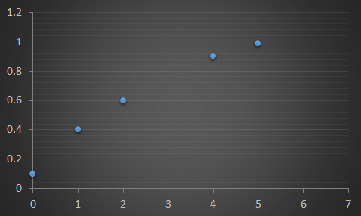
Regression
In training data, there is no e-mail containing 3 “free”.
p(yes|x_{free})
p(yes| x_{free} = 1 ) = 0.4
p(yes| x_{free} = 0 ) = 0.1
Frequency of “Free” (x_{free}) in an e-mail x
Problem: What if one day you receive an e-mail with 3 “free” ….

Slide 8
Regression
f(x_{free}) = wx_{free} + b
(f(x_{free}) is an estimate of p(yes|x_{free}) )
Store w and b
Regression
p(yes|x_{free})
Frequency of “Free” (x_{free}) in an e-mail x

Slide 9
Regression
f(x_{free}) = wx_{free} + b
The output of f is not between 0 and 1
Regression
p(yes|x_{free})
Frequency of “Free” (x_{free}) in an e-mail x
Problem: What if one day you receive an e-mail with 6 “free” ….

Slide 10
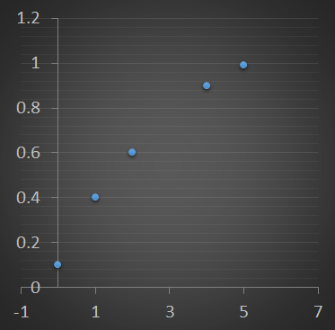
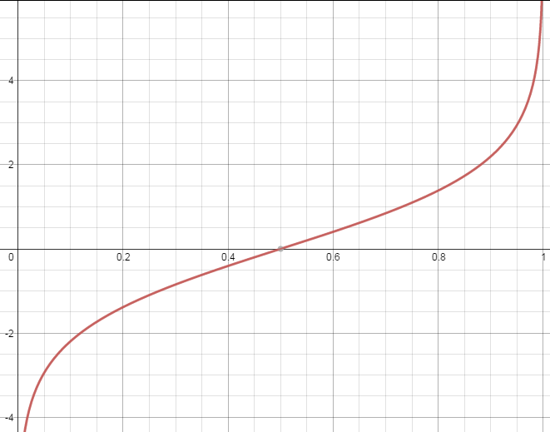
Logit
x_{free}
vertical line: Probability to be spam p(yes|x_{free}) (p)
vertical line: logit(p)
p is always between 0 and 1
Notes:
p is always between 0 and 1, but the output of regreesion is not

Slide 11
Logit
f’(x_{free}) = w’x_{free} + b’
(f’(x_{free}) is an estimate of logit(p) )
x_{free}
x_{free}
vertical line: Probability to be spam p(yes|x_{free}) (p)
vertical line: logit(p)
p is always between 0 and 1
Notes:
p is always between 0 and 1, but the output of regreesion is not

Slide 12
Logit
f’(x_{free}) = w’x_{free} + b’
(f’(x_{free}) is an estimate of logit(p) )
Store w’ and b’
> 0.5, so “yes”
x_{free}
vertical line: logit(p)
“yes”
Notes:
p is always between 0 and 1, but the output of regreesion is not

Slide 13
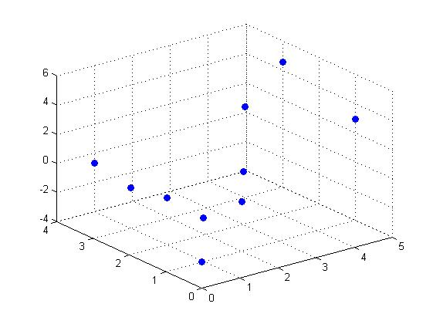
Multiple Variables
Consider two words “free” and “hello”
compute p(yes|x_{free},x_{hello}) (p)
x_{hello}
x_{free}

Slide 14
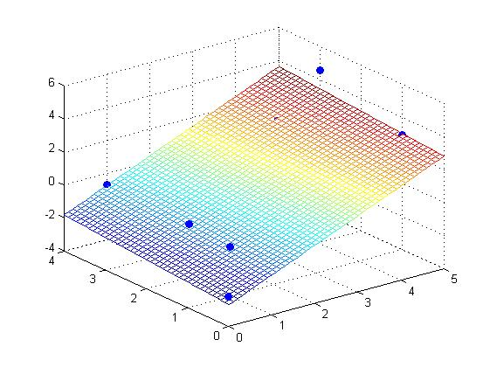
Multiple Variables
Consider two words “free” and “hello”
compute p(yes|x_{free},x_{hello}) (p)
Regression
x_{hello}
x_{free}
Notes:
Free has larger influence!
Hello smaller!
How about new

Slide 15
Multiple Variables
Of course, we can consider all words {t₁, t₂, … t_{N}} in a dictionary
z is to approximate logit(p)

Slide 16
Logistic Regression
approximate
If the probability p = 1 or 0, ln(p/1-p) = +infinity or –infinity
Can not do regression
The probability to be spam p is always 1 or 0.
t₁ appears 3 times
t₂ appears 0 time
…
t_{N} appears 1 time
x

Slide 17
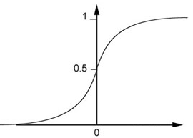
Logistic Regression
Sigmoid
Function

Slide 18
Logistic Regression
1
x¹
close to
Yes (Spam)
0
x²
close to
No (not Spam)
Notes:
Yes prob 1 so 1
No prob 0 so 0

Slide 19
Logistic Regression
This is a neuron in
neural network.
1
…
Yes
0
No
feature
bias
Notes:
Yes prob 1 so 1
No prob 0 so 0
We can understand this model intuitively
Use a feature to describe the input object
You can use any thing as your feature
Address:
e-mail of your boss
Length
Weight has meaning
Bias – tend to
Why sigmoid

Slide 20
More than saying “yes/no”
Multiclass Classification

Slide 21
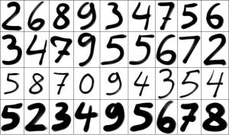
More than saying “yes/no”
Handwriting digit classification
This is Multiclass Classification
Notes:
https://mathematicaforprediction.wordpress.com/2013/08/26/classification-of-handwritten-digits/

Slide 22
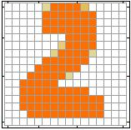
More than saying “yes/no”
Handwriting digit classification
Simplify the question: whether an image is “2” or not
Describe the characteristics of input object
…
Each pixel corresponds to one dimension in the feature
feature
of an image
Notes:
P(yes|first pixel is 1, second pixel is zero) not saying that
Because already mention neuron

Slide 23
More than saying “yes/no”
Handwriting digit classification
Simplify the question: whether an image is “2” or not
“2” or not
…

Slide 24
More than saying “yes/no”
If y₂ is the max, then the image is “2”.
Handwriting digit classification
Binary classification of 1, 2, 3 …
“1” or not
“2” or not
…
“3” or not
……
……

Slide 25
This is not good enough …
Notes:
Motivation of
cascading neurons

Slide 26
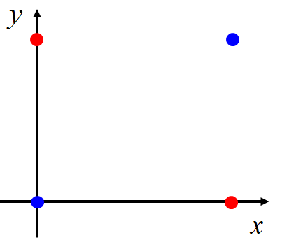
Limitation of Logistic Regression
Input |  | Output
x₁ | x₂
0 | 0 | No
0 | 1 | Yes
1 | 0 | Yes
1 | 1 | No
Yes
No
Notes:
The preceding example employed typical “opportunistic,” or found, data. But even data generated by a designed experiment need external information. A DoD project from the early days of neural networks attempted to distinguish aerial images of forests with and without tanks in them. Perfect performance was achieved on the training set, and then on an outof-sample set of data that had been gathered at the same time but not used for training. This was celebrated but, wisely, a confirming study was performed. New images were collected on which the models performed extremely poorly. This drove investigation into the features driving the models and revealed them to be magnitude readings from specific locations of the images; i.e., background pixels. It turns out that the day the tanks had been photographed was sunny, and that for nontanks, cloudy!11 Even resampling the original data wouldn’t have protected against this error, as the flaw was inherent in the generating experiment.
PBS featured this project in a 1991 documentary series The Machine That Changed the World: Episode IV, “The Thinking Machine.”

Slide 27
So we need neural network ……
Input
Layer 1
Layer 2
Layer L
Output
……
y₁
……
y₂
……
……
……
……
……
……
y_{M}
Deep means many layers

Slide 28
Thank you for your listening!

Slide 29
Appendix

Slide 30
More reference
http://www.ccs.neu.edu/home/vip/teach/MLcourse/2_GD_REG_pton_NN/lecture_notes/logistic_regression_loss_function/logistic_regression_loss.pdf
http://mathgotchas.blogspot.tw/2011/10/why-is-error-function-minimized-in.html
https://cs.nyu.edu/~yann/talks/lecun-20071207-nonconvex.pdf
http://www.cs.columbia.edu/~blei/fogm/lectures/glms.pdf
http://grzegorz.chrupala.me/papers/ml4nlp/linear-classifiers.pdf

